Slide 1
GOLD CHALLENGE
MAKE API FOR DATA CLEANSING
DAVINCA RIZQY ADINDA ISMAIL DATA SCIENCE 5
Email : davincarizqy78@gmail.com
Github : https://github.com/Davinca23

Slide 2
Table of contents
02
01
03
Preliminary
Research Methods
Result & Conclusion

Slide 3
01
Preliminary
CONCEPT OF API FOR DATA CLEANSING

Slide 4
THE CONCEPT OF HOW THE API FOR DATA CLEANSING WORKS
API
User
Application / Data
User will input text or file to be cleaned
Application or 'kitchen' that will cleanse text or file that have been inputted by the user.

Slide 5
02
Research Methods
HOW CAN WE MAKE API FOR DATA CLEANSING & HOW CAN WE USE IT

Slide 6
How can we make API for data cleansing?
01
02
03
Flask and HTML
Routing Endpoint & Make Pattern
Swagger UI
Use Flask to create a framework used to create web-based applications. Also create HTML code to build the interface.
Make 2 endpoint for each (1 for text & 1 for file) & make patterns for cleansing the text & file.
Add Swagger UI to the python script to document the API

Slide 7
How can we use API for data cleansing?
01
02
03
Input text or file to be cleaned
Result
Choose Endpoint
Choose ‘/’ endpoint to cleanse file or choose ‘/text’ to cleanse text in a form .
Click ‘choose’ button to choose a file to be cleaned or if you want to cleanse text, input your text in a form, and then click submit/upload button.
Now you have text or file that already cleaned and ready to be analyzed.

Slide 8
Data Preparation
01
02
03
Storing/ Saving Data Into Database (using SQLite3)
Merge The Data
Result
We can make 1 more python file to merge original data and the cleaned data using pandas.
Now you have a ready-to-use data in sql table. Also it is ready-to-analyze.
We turn the results of the merged data into an sql table (connection to the database) in different python file. Even we can also analyze the table.

Slide 9
03
Result & Conclusion
Analyzing The Data That Already Cleaned

Slide 10
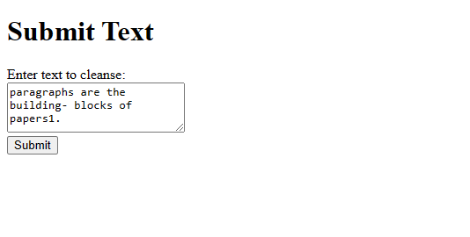
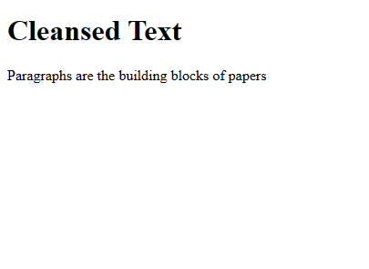
Cleanse Text
What we cleanse:
~Capital letter at the beginning of the paragraph
~Meaningless numeric
~Cleaning punctuation
~Meaningless whitespace

Slide 11
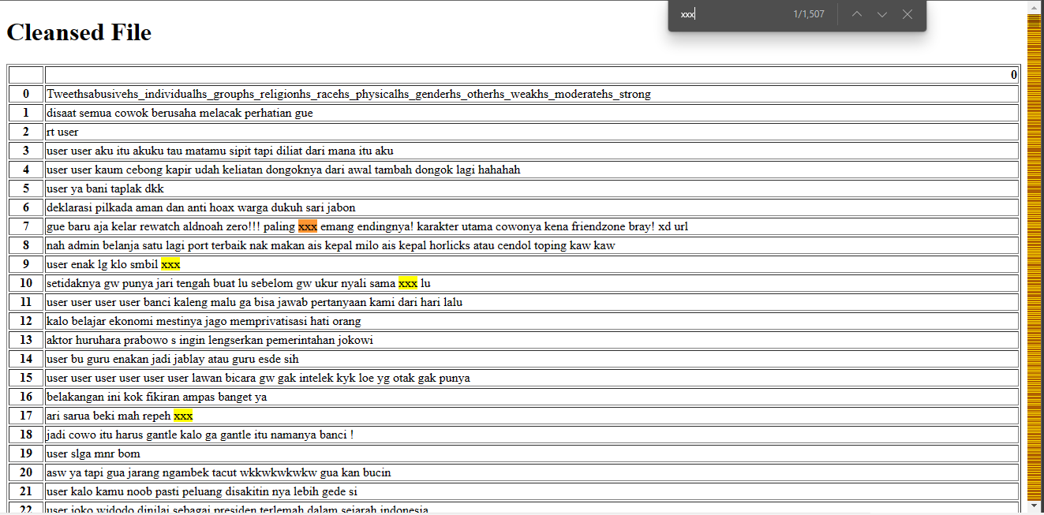
Ctrl+F to search XXX
Cleanse File
What we cleanse:
~Missing values
~Meaningless numeric
~Censoring
~Lowercase
~Meaningless whitespace or \n
1507
BAD WORDS
(Censored As XXX)

Slide 12
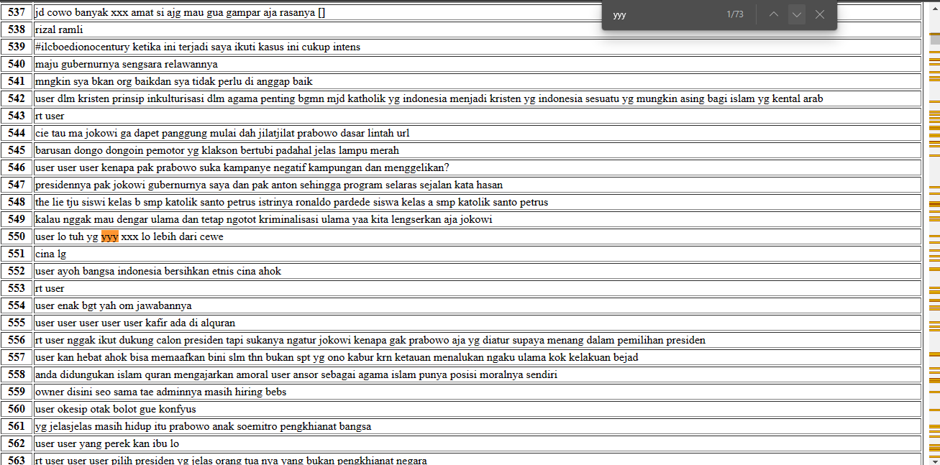
Ctrl+F to search YYY
What we cleanse:
~Missing values
~Meaningless numeric
~Censoring
~Lowercase
~Meaningless whitespace or \n
73
BODY SHAMING
(Censored As YYY)

Slide 13
The context in which the harsh words and hate speech are used (in what type of conversations or discussions, etc.)
Political discussions or debates.
Discussions or debates about social or cultural issues, such as race, gender, sexual orientation, religion, etc.
Online discussions or comments on news articles or social media posts.
Interactions on online forums or chat rooms.
Personal conversations or interactions between individuals.

Slide 14
The potential impact or harm caused by the hate speech
Psychological Harm
Legal Harm
Economic Harm
Social Harm
Political Harm

Slide 15
What’s the point of censoring swear words when we use social media or body shaming words?
Lots of minors are using social media nowadays. It can prevent them from learning bad words or using body-shaming words on others.
It can create a social media environment that is healthy and non-toxic

Slide 16
CONCLUSION
Data Cleansing can be very useful to apply to your work, as it can produce data that is ready to analyze.
You can cleanse noisy data, missing values, or anything else that might interfere with your data processing.

Slide 17
Thank You

